Slide 1
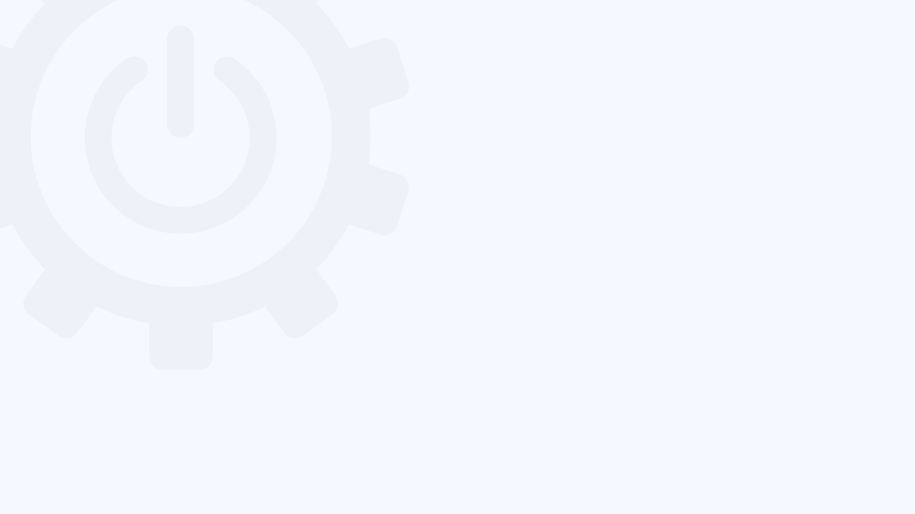
WORK SMARTER WITH AI:
Notes:
There are some elements of these slides that may seem out of place or redundant if you are looking at each static slide. Play the slideshow to see the slides as intended.

Slide 2
OBJECTIVE
Participants will be able to identify their next step for using AI more effectively in their daily work — whether that means trying it for the first time or expanding how they already use it.
Notes:
There are some elements of these slides that may seem out of place or redundant if you are looking at each static slide. Play the slideshow to see the slides as intended.

Slide 3



EXPECTATIONS
There’s a lot of hype about AI, but let’s be practical.
The goal here is to reduce friction — not your role.
And remember....
YOU STAY
IN CONTROL
MEET WHERE YOU ARE
NO TECHNICAL SKILLS REQUIRED
Output is reviewed
and edited by you.
AI can suggest;
but you still decide.
Whether you've never tried AI or you use it daily, there's a next
step for you.
If you can type a question or describe what you need,
you can do this.
Notes:
There are some elements of these slides that may seem out of place or redundant if you are looking at each static slide. Play the slideshow to see the slides as intended.

Slide 4
EXPECTATIONS
There’s a lot of hype about AI, but let’s be practical.
The goal here is to reduce friction — not your role.
And remember....
KEEP AN
OPEN MIND
YOU STAY
IN CONTROL
MEET WHERE YOU ARE
NO TECHNICAL SKILLS REQUIRED
Output is reviewed
and edited by you.
AI can suggest;
but you still decide.
Whether you've never tried AI or you use it daily, there's a next
step for you.
If you can type a question or describe what you need,
you can do this.
Notes:
There are some elements of these slides that may seem out of place or redundant if you are looking at each static slide. Play the slideshow to see the slides as intended.

Slide 5


AI EXAMPLES ROADMAP
We will be providing examples, working from most accessible to most advanced.
Notes:
There are some elements of these slides that may seem out of place or redundant if you are looking at each static slide. Play the slideshow to see the slides as intended.

Slide 6

LEVEL 1 - ASK A QUESTION, GET AN ANSWER
OLD WAY
WITH AI
EXAMPLES
Google a question, sift through links, piece together
an answer, hope it's right.
Ask a question, get a direct answer, ask follow-ups if you need to know more.
“What's the difference between a W-4 and a W-9?”
“How do I write a professional out-of-office message?”
“What does 'net 30' mean on an invoice?”
Notes:
There are some elements of these slides that may seem out of place or redundant if you are looking at each static slide. Play the slideshow to see the slides as intended.

Slide 7

LEVEL 2 - GET A DRAFT INSTEAD OF A BLANK PAGE
OLD WAY
WITH AI
EXAMPLES
Stare at a blank screen. Write a sentence. Delete it.
Start over. Put it off until tomorrow.
Describe what you need.
Get a
starting draft. Edit it into
your voice.
Done.
“Draft an email to a client apologizing for a shipping delay.”
“Write a short status update on our Q3 project progress.”
“Help me phrase a request to reschedule a meeting.”
Notes:
There are some elements of these slides that may seem out of place or redundant if you are looking at each static slide. Play the slideshow to see the slides as intended.

Slide 8

LEVEL 3 - USE AI TO THINK, NOT JUST WRITE
BASIC USE
NEXT LEVEL
EXAMPLES
Ask a question, get an answer. Ask for a draft, get a draft.
One input, one output.
Have a conversation.
Talk through decisions. Ask it to challenge your thinking or show you what you might be missing.
“Here's my plan — what am I not considering?”
“Play devil's advocate on this decision.”
“Help me think through the pros and cons of these two options.”
Notes:
There are some elements of these slides that may seem out of place or redundant if you are looking at each static slide. Play the slideshow to see the slides as intended.

Slide 9

LEVEL 4 - CHAIN TASKS INTO WORKFLOWS
SINGLE TASKS
WORKFLOWS
EXAMPLES
One request
at a time.
Summarize this. Draft that.
Each task is separate.
Chain tasks together. Transform formats. Build on previous outputs. Orchestrate multi-step processes.
“Summarize these notes, then turn them into an outline, then draft talking points from that outline.”
“Convert this report into a two-paragraph summary for executives.”
Notes:
There are some elements of these slides that may seem out of place or redundant if you are looking at each static slide. Play the slideshow to see the slides as intended.

Slide 10
GETTING GOOD RESULTS
1
BE SPECIFIC ABOUT WHAT YOU WANT
"Write a follow-up email about the delayed shipment" beats "write an email”.
2
GIVE CONTEXT
Who's the audience? What's the goal? What tone are you going for?
3
ITERATE — DON'T EXPECT PERFECTION
The first response is a starting point. Say "make it shorter" or "more formal”.
4
YOU'RE THE EDITOR, NOT THE AUDIENCE
Always review before using. The AI drafts; you decide what ships.
Notes:
There are some elements of these slides that may seem out of place or redundant if you are looking at each static slide. Play the slideshow to see the slides as intended.

Slide 11

FIND YOUR NEXT STEP
Goal for this week:
Pick a task from your level. Try it with AI. Notice what works and what doesn’t to learn what has value for you.
LEVEL 4 - BUILD WORKFLOWS
LEVEL 3 - THINK TOGETHER
LEVEL 2 - GET DRAFTS
LEVEL 1 - ASK QUESTIONS
Notes:
There are some elements of these slides that may seem out of place or redundant if you are looking at each static slide. Play the slideshow to see the slides as intended.

Slide 12

QUESTIONS
Notes:
There are some elements of these slides that may seem out of place or redundant if you are looking at each static slide. Play the slideshow to see the slides as intended.

